Slide 1
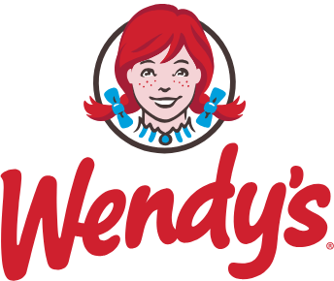
AI Agents Hackathon @ Wendy’s
Serving fresh ideas with a side of AI
Confidential
01-10-2025
Biru Dash

Slide 2
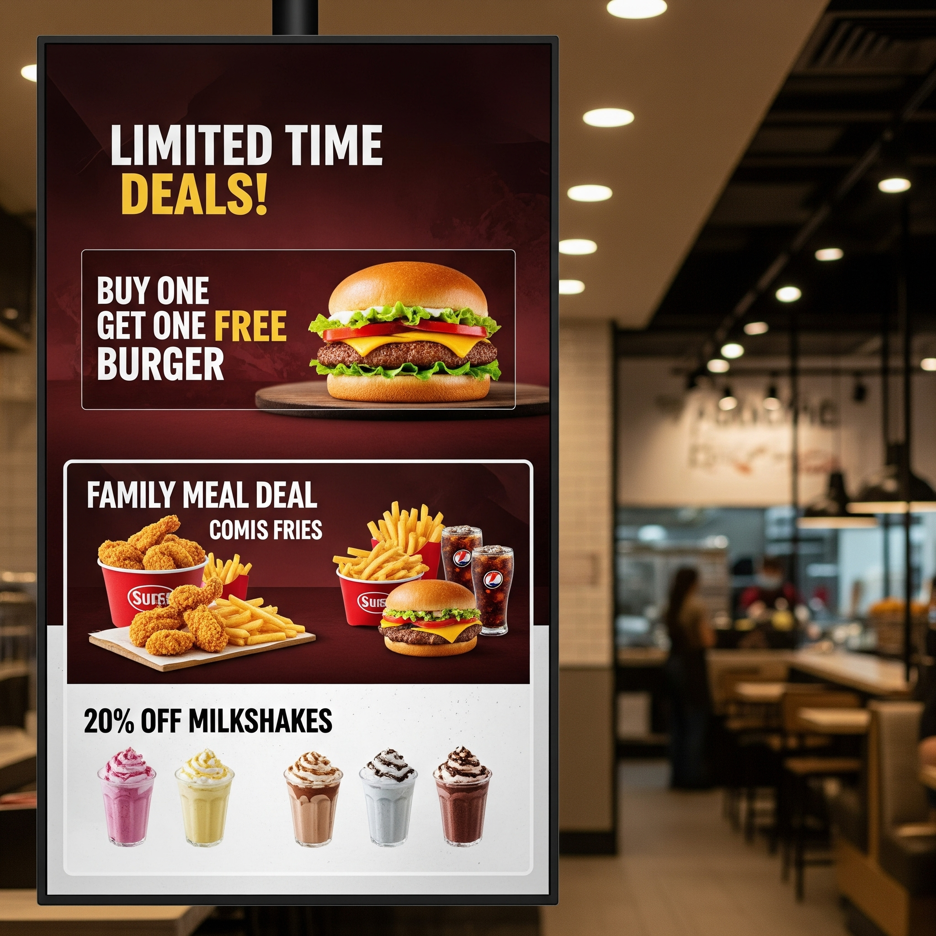
Wendy's Hackathon: Agentic AI for Offer Innovation
Reimagine how Wendy’s designs promotional offers using a team of AI agents that sense market signals, learn from the past, and propose data-driven offer ideas.
Theme
Move beyond guesswork and static analysis.Build an agent mesh that continuously gathers, reasons, and synthesizes signals from: customers, competitors, and market trends.
Objectives:
Design a multi-agent system that collaborates to propose 3 innovative promotional offers for Wendy’s.
Each idea must be grounded in: customer preferences, historical learnings, and competitive signals.
No heavy forecasting/pricing required — focus on signal-driven design and rationale.
Outcome
Fresh, evidence-backed offer ideas showcasing the capabilities of building a multi-agent system leveraging GCP technologies.

Slide 3








Agent Mesh Overview
Objective
Demonstrate a multi-agent interaction within the Gemini + GCP ecosystem
Services we will use today
Agents we will use today
Agent Development
Competitor Intelligence
Data Layer
Market Trends & Deep Research
Customer Insights
Offer Design
Agent orchestration & communication
Plan
Context Access
Setup & Brief
Build & Extend
Integrate
Demo
Front-end

Slide 4
Market Trends & Deep Research
An agent to identify “What’s changing out there?"
Agent Description
Tasks
Detect new offer mechanics and rising themes (e.g., gamification, subscriptions, surprise rewards).
Measure velocity and novelty (how fast a trend is growing and how unique it is).
Summarize consumer language and narratives around value and perception.
Pull representative quotes or links for traceability.
Inputs
Public social data (Reddit threads)
Press articles, food blogs, trend reports, Google Search trends
Outputs
trend_briefs[] - small structured artifacts containing: title, short summary, evidence snippets, signal strength (e.g., velocity), and recommended directions to explore.
Example output
“Meal subscription offers are trending on Reddit (+180% mentions in 4 weeks), with Gen Z associating them with ‘VIP treatment.’”
Purpose
Continuously scan external channels to uncover emerging behaviors, conversations, and sentiments around fast-food offers, deals, and promotions — providing the forward-looking context teams need to ideate.

Slide 5
Customer Insights
An agent to identify “What does our audience respond to?"
Agent Description
Tasks
Segment customers by sensitivity and preferences (discount hunters, loyal repeaters, convenience-driven).
Calculate redemption patterns, uplift signals, and time/channel dependencies (e.g., app-only lift).
Extract sentiment drivers and messaging cues from feedback.
Highlight shifting behaviors (e.g., growing app-first redemptions).
Inputs
Loyalty and CRM data (visits, spend, redemptions)
Redemption logs and offer history
Past campaign feedback, reviews, and social comments (synthetic data allowed)
Outputs
customer_insights[] - structured profiles for segments: segment_id, description, preferred mechanics, key messaging phrases, empirical metrics (redemption_rate, lift estimates).
Example output
“Value-driven weekday lunch buyers redeem BOGO offers 2.3× more often if they are time-boxed and app-exclusive.”
Purpose
Understand what customers value in offers by analyzing behavioral signals and historical sentiment to create actionable segment-level preferences.

Slide 6
Competitor Intelligence
An agent to identify “What are others doing?"
Agent Description
Tasks
Build a structured catalog of competitor promotions (mechanic, duration, channel, target audience).
Identify novel tactics and measure frequency/adoption across competitors.
Surface whitespace opportunities where Wendy’s is under-indexed.
Inputs
Public competitor sources (websites, press releases, social posts)
Loyalty program mechanics and observed campaign mechanics
Any third-party reporting or benchmark metrics (if available)
Outputs
competitive_landscape[] - rows of competitor mechanics with metadata (brand, mechanic, duration, reported lift if known).
whitespace_opportunities[] — targeted opportunity statements with rationale.
Example output
“McDonald’s launched a weekly gamified app challenge driving 28% lift in engagement — Wendy’s has no equivalent mechanic.”
Purpose
Track, summarize, and contextualize competitor promotions to reveal opportunities, gaps, and inspiration for differentiated offers.

Slide 7
Offer Design
An agent to identify “What should Wendy’s launch next?"
Agent Description
Tasks
Combine signals to generate candidate offer mechanics and concepts.
Define offer structure: mechanic, channel, duration, target segment, and success metrics.
Provide concise rationale and cite which inputs supported each design decision.
Prioritize concepts by feasibility and expected impact.
Inputs
Trend_briefs[] from Market Trends & Deep Research agent.
Customer_insights[] from Customer Insights agent
competitive_landscape[] and whitespace_opportunities[] from Competitor Intelligence agent.
Outputs
offer_concepts[] - fully described offers (name, mechanic, channel, duration, target, evidence map linking to inputs, and success hypotheses).
Example output
Name: “Wendy’s Streak Week” — Daily app-only challenges with growing rewards. Why: Aligns with Gen Z gamification trend (Market Trends & Deep Research agent), leverages app-first audience (Customer Insights agent), and fills a competitive gap (Competitor Intelligence agent).
Purpose
Synthesize trend, customer, and competitor signals into concrete, evidence-backed offer concepts that are brand-aligned and actionable.

Slide 8
Agentic Flow
Detects new promotion styles and narratives.
Market Trends & Deep Research Agent
Profiles which segments value which mechanics.
Synthesizes and outputs 2–3 offer concepts.
Orchestrator
Offer Design
Customer Insights Agent
Maps the landscape and surfaces whitespace.
Competitor Intelligence Agent

Slide 9
Data
Judging Criteria
Code and instructions for the hackathon - Click Here
Colab notebook used for creating synthetic data: Click Here
S:Signal Quality & Depth (30%) - Is the idea backed by clear, traceable evidence?
O:Offer Creativity (30%) - Is the offer original and differentiated?
A: Agent Collaboration (25%) - Do agents hand-off cleanly and build on each other’s work?
C: Clarity & Storytelling (15%) - Is the pitch/demo concise and easy to understand

Slide 10
Thank You

